Slide 1
Software Project Management

Slide 2
Importance of Software Project Management
On average, money spent on IT and software projects has been increasing on the order of 10% or more annually for the last 30 years worldwide.
In the United Kingdom during the financial year of 2002-2003, the central government spent more on contracts for ICT Projects than on contracts related to roads (about £2.3 billion as opposed to £1.4 billions).
In a report published in 2003, the Standish group in the united states analysed 13,522 projects and concluded that only a third of projects were successful, 82% of their projects were late and 43% exceeded their budget.
The National Audit Office in the UK, among other factors causing project failure identified ‘lack of skills and proven approach to project management and risk management’.

Slide 3
What is Software ?
Software is Computer programs, procedures, and possibly associated documentation and data pertaining to the operation of a computer system.
The IEEE definition of software, which is almost identical to the ISO definition (ISO, 1997, Sec. 3.11 and ISO/IEC 9000-3 Sec. 3.14), lists the following four components of software:
Computer programs (the “code”)
Procedures
Documentation
Data necessary for operating the software system.

Slide 4
What is Project?
A Project is “a temporary attempt undertaken to create a unique product, service, or result”.
Project Attributes:
A project has a unique purpose
A Project is temporary
A Project is developed using progressive elaboration
A Project requires resources
A Project should have a primary customer or sponsor
A project involves uncertainty

Slide 5
Project
A project can create:
A product that can be either a component of another item, an enhancement of an item, or an end item in itself.
A service or a capability to perform a service (e.g., a business function that supports production or distribution).
An improvement in the existing product or service lines (e.g., A Six Sigma project undertaken to reduce defects).
A result, such as an outcome or document (e.g., a research project that develops knowledge that can be used to determine whether a trend exists or a new process will benefit society).

Slide 6
What is Management?
Basically, the management involves the following activities:
Planning- deciding what is to be done
Organizing- making arrangements
Staffing- selecting the right people for the job
Directing- giving instructions
Monitoring- checking on progress
Controlling- taking action to remedy hold-ups
Innovating- coming up with new solutions
Representing- liaising with users, etc.

Slide 7
Why we need Management
To increase the productivity
To save time
To organize task in daily life
To avoid wastage of resources

Slide 8
Software Project Management
A goal of any software project management is to develop/maintain a software product by applying good project management principles as well as software engineering principles so that the software project is delivered at minimum cost, within minimum time, and with good product quality.
Good project management principles will ensure good productivity. Good productivity in turn will ensure that the project is delivered in minimum time at minimum cost.

Slide 9



How to avoid problems?
Reel’s five step approach for successful projects
Start on the right foot
Involves detailed understanding of project
Setting realistic objectives & expectations
Selecting the right team
Facilitating the team
Maintain Momentum
Provide incentives
Reduce bureaucracy and give autonomy to team members but with supervision
Track Progress
Assess progress as work products are produced

Slide 10



How to avoid problems?
Make smart decisions
When possible, use existing software components / COTS software
Choose standard approaches and keep it simple
Avoid risks and allocate more time than needed for complex/risky tasks
Conduct a postmortem analysis
Compare planned and actual schedule
Collect and analyze project metrics
Get feedback from team and customer
Establish record of lessons learnt for each project

Slide 11
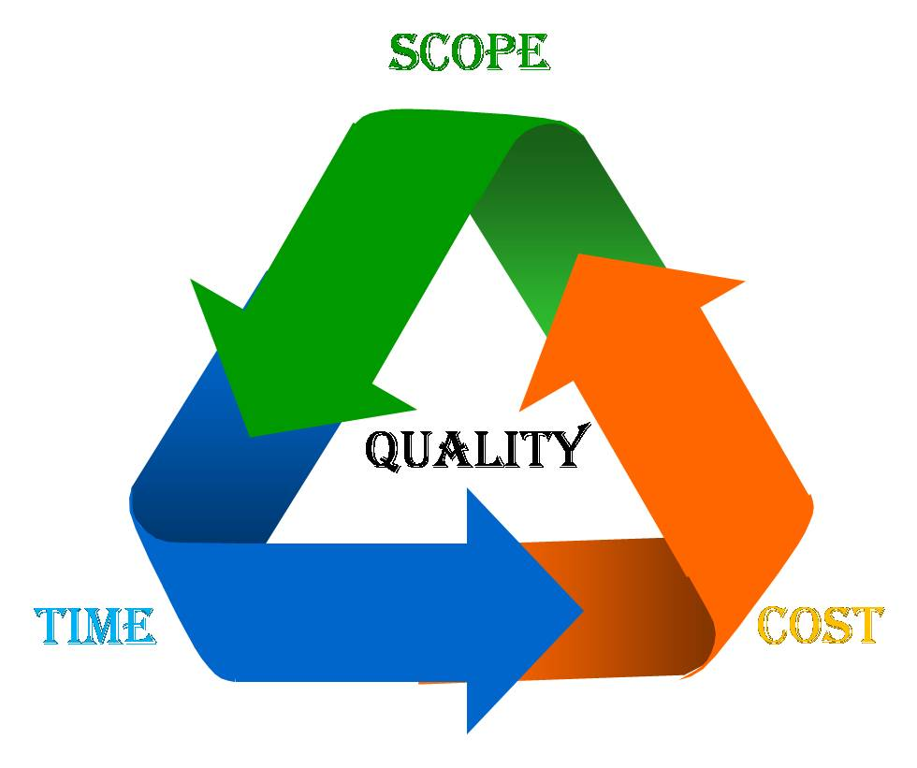
The Quadruple Constraints of Software Project Management

Slide 12
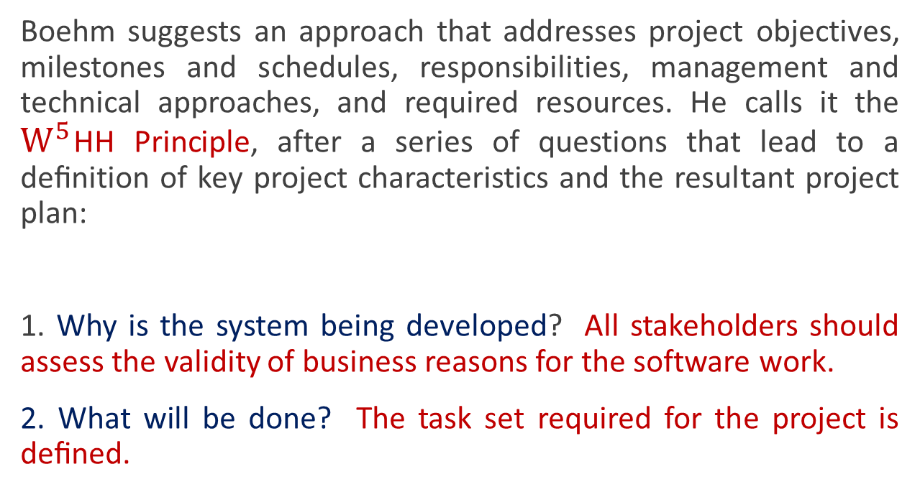

$W^{5}$HH Principle
Boehm suggests an approach that addresses project objectives, milestones and schedules, responsibilities, management and technical approaches, and required resources. He calls it the $W^{5}$HH Principle, after a series of questions that lead to a deﬁnition of key project characteristics and the resultant project plan:
1. Why is the system being developed? All stakeholders should assess the validity of business reasons for the software work.
2. What will be done? The task set required for the project is deﬁned.

Slide 13
$W^{5}$HH Principle
When will it be done? The team establishes a project schedule.
Who is responsible for a function? The role and responsibility of each member of the software team is deﬁned.
Where are they located organizationally? Not all roles and responsibilities reside within software practitioners.
How will the job be done technically and managerially? Management and technical strategy for the project must be deﬁned.
How much of each resource is needed?

Slide 14
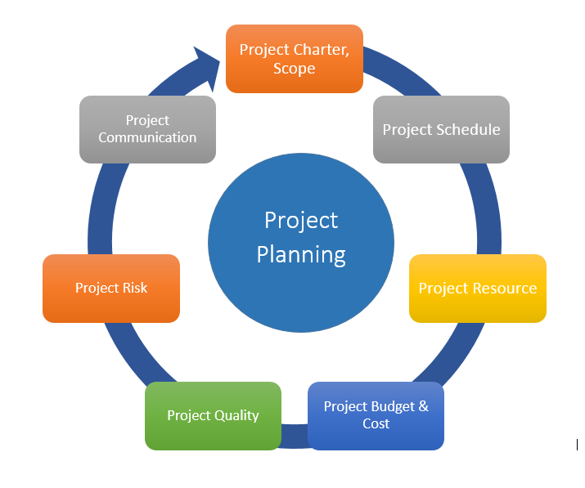

Slide 15
PMBOK(Project Management Body of Knowledge)
Structures PM by
Processes
Knowledge Areas
Processes. 2 types
PM processes: describing and organizing the work of the project
Product-oriented processes: specifying and building the project’s product

Slide 16
PMI Process Groups
Initiating
Planning
Executing
Controlling
Closing
Each process is described by:
Inputs
Tools & Techniques
Outputs

Slide 17
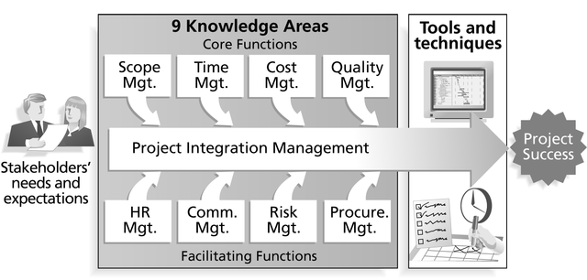
PMI Framework
10th Knowledge Area Stakeholders Management

Slide 18
Configuration Management

Slide 19
Configuration management
Because software changes frequently, systems, can be thought of as a set of versions, each of which has to be maintained and managed.
Versions implement proposals for change, corrections of faults, and adaptations for different hardware and operating systems.
Configuration management (CM) is concerned with the policies, processes and tools for managing changing software systems. You need CM because it is easy to lose track of what changes and component versions have been incorporated into each system version.

Slide 20
CM activities
Change management
Keeping track of requests for changes to the software from customers and developers, working out the costs and impact of changes, and deciding the changes should be implemented.
Version management
Keeping track of the multiple versions of system components and ensuring that changes made to components by different developers do not interfere with each other.
System building
The process of assembling program components, data and libraries, then compiling these to create an executable system.
Release management
Preparing software for external release and keeping track of the system versions that have been released for customer use.

Slide 21
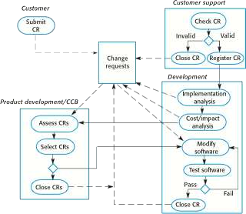
The change management process

Slide 22
Change request form (a)
Change Request Form Project: SICSA/AppProcessingNumber: 23/02
Change requester: I. SommervilleDate: 20/01/09
Requested change: The status of applicants (rejected, accepted, etc.) should be shown visually in the displayed list of applicants.
Change analyzer: R. LooekAnalysis date: 25/01/09
Components affected: ApplicantListDisplay, StatusUpdater
Associated components: StudentDatabase

Slide 23
Change request form (b)
Change Request Form
Change assessment: Relatively simple to implement by changing the display color according to status. A table must be added to relate status to colors. No changes to associated components are required.
Change priority: Medium Change implementation: Estimated effort: 2 hours
Date to SGA app. team: 28/01/09
CCB decision date: 30/01/09
Decision: Accept change. Change to be implemented in Release 1.2
Change implementor: Date submitted to QA: Date submitted to CM: Comments:
Date of change: QA decision:

Slide 24
Factors in change analysis
The consequences of not making the change
The benefits of the change
The number of users affected by the change
The costs of making the change
The product release cycle

Slide 25
Change management and agile methods
In agile methods, customers are directly involved in change management.
They propose a change to the requirements and work with the team to assess its impact and decide whether the change should take priority over the features planned for the next increment of the system.
Changes to improve the software improvement are decided by the programmers working on the system.

Slide 26
Version management
Version management (VM) is the process of keeping track of different versions of software components or configuration items and the systems in which these components are used.
It also involves ensuring that changes made by different developers to these versions do not interfere with each other.
Therefore, version management can be thought of as the process of managing codelines and baselines.

Slide 27
Version management systems
Version and release identification
Managed versions are assigned identifiers when they are submitted to the system.
Storage management
To reduce the storage space required by multiple versions of components that differ only slightly, version management systems usually provide storage management facilities.
Change history recording
All of the changes made to the code of a system or component are recorded and listed.
Project support
A version management system may support the development of several projects, which share components.

Slide 28
System building
System building is the process of creating a complete, executable system by compiling and linking the system components, external libraries, configuration files, etc.
System building tools and version management tools must communicate as the build process involves checking out component versions from the repository managed by the version management system.

Slide 29
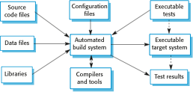
System building

Slide 30
Release management
A system release is a version of a software system that is distributed to customers.
For mass market software, it is usually possible to identify two types of release: major releases which deliver significant new functionality, and minor releases, which repair bugs and fix customer problems that have been reported.
For custom software or software product lines, releases of the system may have to be produced for each customer and individual customers may be running several different releases of the system at the same time.

